Slide 1


> dotnet tour
Scott Addie
Senior Content Developer
@Scott_Addie

Slide 2
Agenda
CLI overview
Frequently used commands
SDK pinning
VS Code integration
Scaffolding
Template creation

Slide 3




What is the .NET Core CLI?
Chassis on which tooling is built
Makes command line 1st class citizen
Works everywhere
Side-by-side installs
Multi-language support
Notes:
Installed w/ .NET Core SDK
C:\Program Files\dotnet\sdk

Slide 4


Learn abstraction below comfort zone
Visual Studio
Visual Studio Code
Visual Studio for Mac
.NET Core CLI
Notes:
Not all commands accounted for in tooling:
dotnet store (create runtime store)
Compare to GitHub for Windows vs. Git command line

Slide 5

Visual Studio
¯\_(ツ)_/¯
.NET Core CLI
(╯°□°）╯︵ ┻━┻
Notes:
“Be the mythical unicorn in a field of horses. Be the outlier with knowledge of the CLI.”

Slide 6
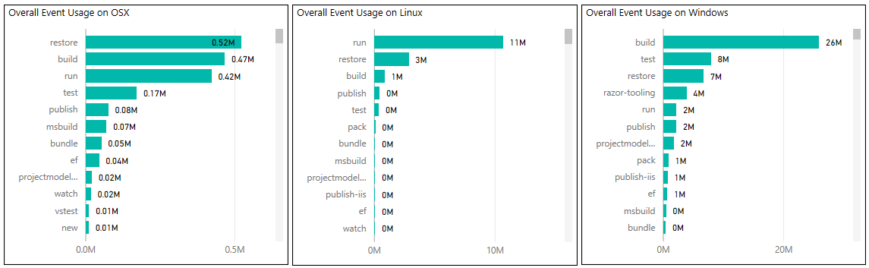
DEMO
Frequently used commands
Notes:
gathered from telemetry in 7/2017
set env. var. to opt out

Slide 7

.NET Core SDK pinning

Slide 8
global.json decision tree
> dotnet new webapp
Does global.json exist?
Does global.json specify a version?
Is SDK version installed?
YES
YES
YES
Use SDK specified in
sdk:version property
NO
NO
NO
Use latest installed
version of SDK
Is patch version of SDK installed?
NO
YES
Throw an error
Notes:
Strategy for managing side-by-side installations of SDK
No globbing or range support (specify full version #)
[major].[minor].[xyz]-[optional preview name]
Patch # = yz
Feature release # = x

Slide 10
Integration with VS Code
Consistent experience on all platforms
Extensions:
C# (OmniSharp)
Azure CLI Tools
Use with…
Command Palette
Integrated Terminal
Tasks

Slide 12

Scaffolding

Slide 13
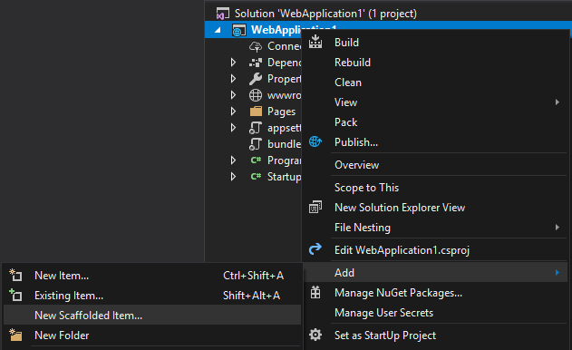
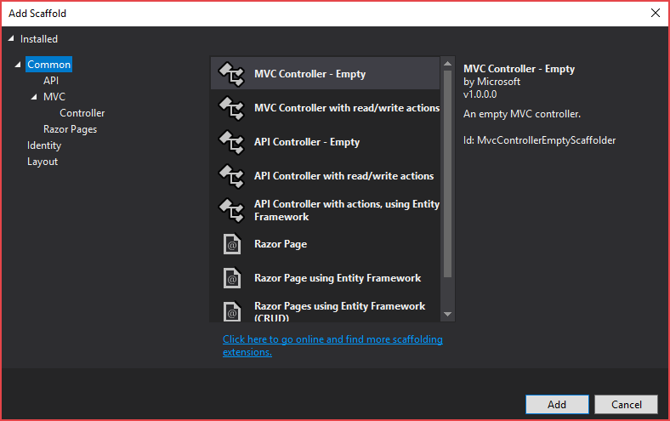
Right-click > Add > New Scaffolded Item…?

Slide 14


Slide 15
Scaffolding prerequisites
1. Install .NET Core global tool:
> dotnet tool install -g dotnet-aspnet-codegenerator --version 2.2.3
2. Install ASP.NET Core code gen. templates:
> dotnet add testapp.csproj package Microsoft.VisualStudio.Web.CodeGeneration.Design
Notes:
Global tool replaces <DotNetCliToolReference /> w/ 2.1+ SDK

Slide 16
Scaffolding tool
C:\working_folder\test_app> dotnet aspnet-codegenerator -h Usage: aspnet-codegenerator [arguments] [options] Arguments: generator Name of the generator. Check available generators below. Options: -p|--project Path to .csproj file in the project. -n|--nuget-package-dir -c|--configuration Configuration for the project (Possible values: Debug/ Release) -tfm|--target-framework Target Framework to use. (Short folder name of the tfm. eg. net46) -b|--build-base-path --no-build Available generators: area : Generates an MVC Area. controller: Generates a controller. identity : Generates an MVC Area with controllers and razorpage : Generates RazorPage(s). view : Generates a view.
testapp.csproj
<Project Sdk="Microsoft.NET.Sdk.Web"> <PropertyGroup> <TargetFramework>netcoreapp2.2</TargetFramework> </PropertyGroup> <ItemGroup> <PackageReference Include="Microsoft.AspNetCore.App" /> <PackageReference Include="Microsoft.VisualStudio.Web.CodeGeneration.Design" Version="2.2.3" /> </ItemGroup> </Project>
Notes:
enables ASP.NET Core item template generation

Slide 17
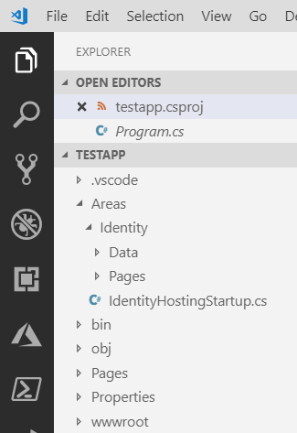

Scaffolding command
C:\working_folder\testapp> dotnet aspnet-codegenerator identity Building project ... Finding the generator 'identity'... Running the generator 'identity'... RunTime 00:00:14.46

Slide 18
Creation of templates
Create .template.config folder
Define metadata in template.json
Create .nuspec file
nuget pack <path_to_nuspec>
dotnet new -i <path_to_nupkg>
Notes:
works for project & item templates
NuGet steps optional if doing file system / network share installation
SideWaffle Template Creator extension for VS ← add templates to VS
github.com/schemastore

Slide 19
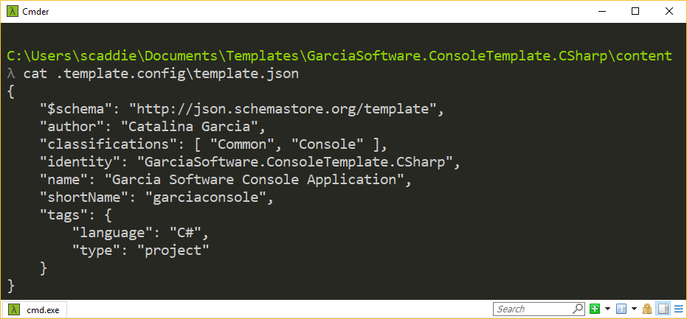
DEMO
Template creation

Slide 20




Resources
Slides:
aka.ms/dotnetcli-slides
Frequent Commands:
aka.ms/dotnetcli-cmd
Templating Commands:
aka.ms/dotnetcli-tmpl
docs.microsoft.com/dotnet/core/tools
@Scott_Addie

